Slide 1
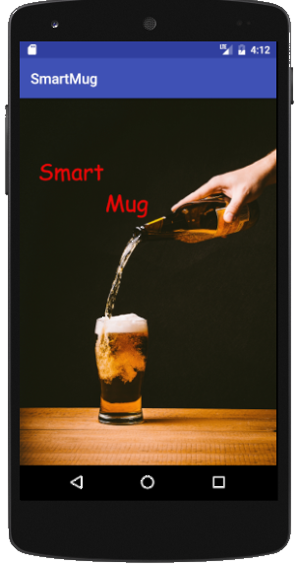
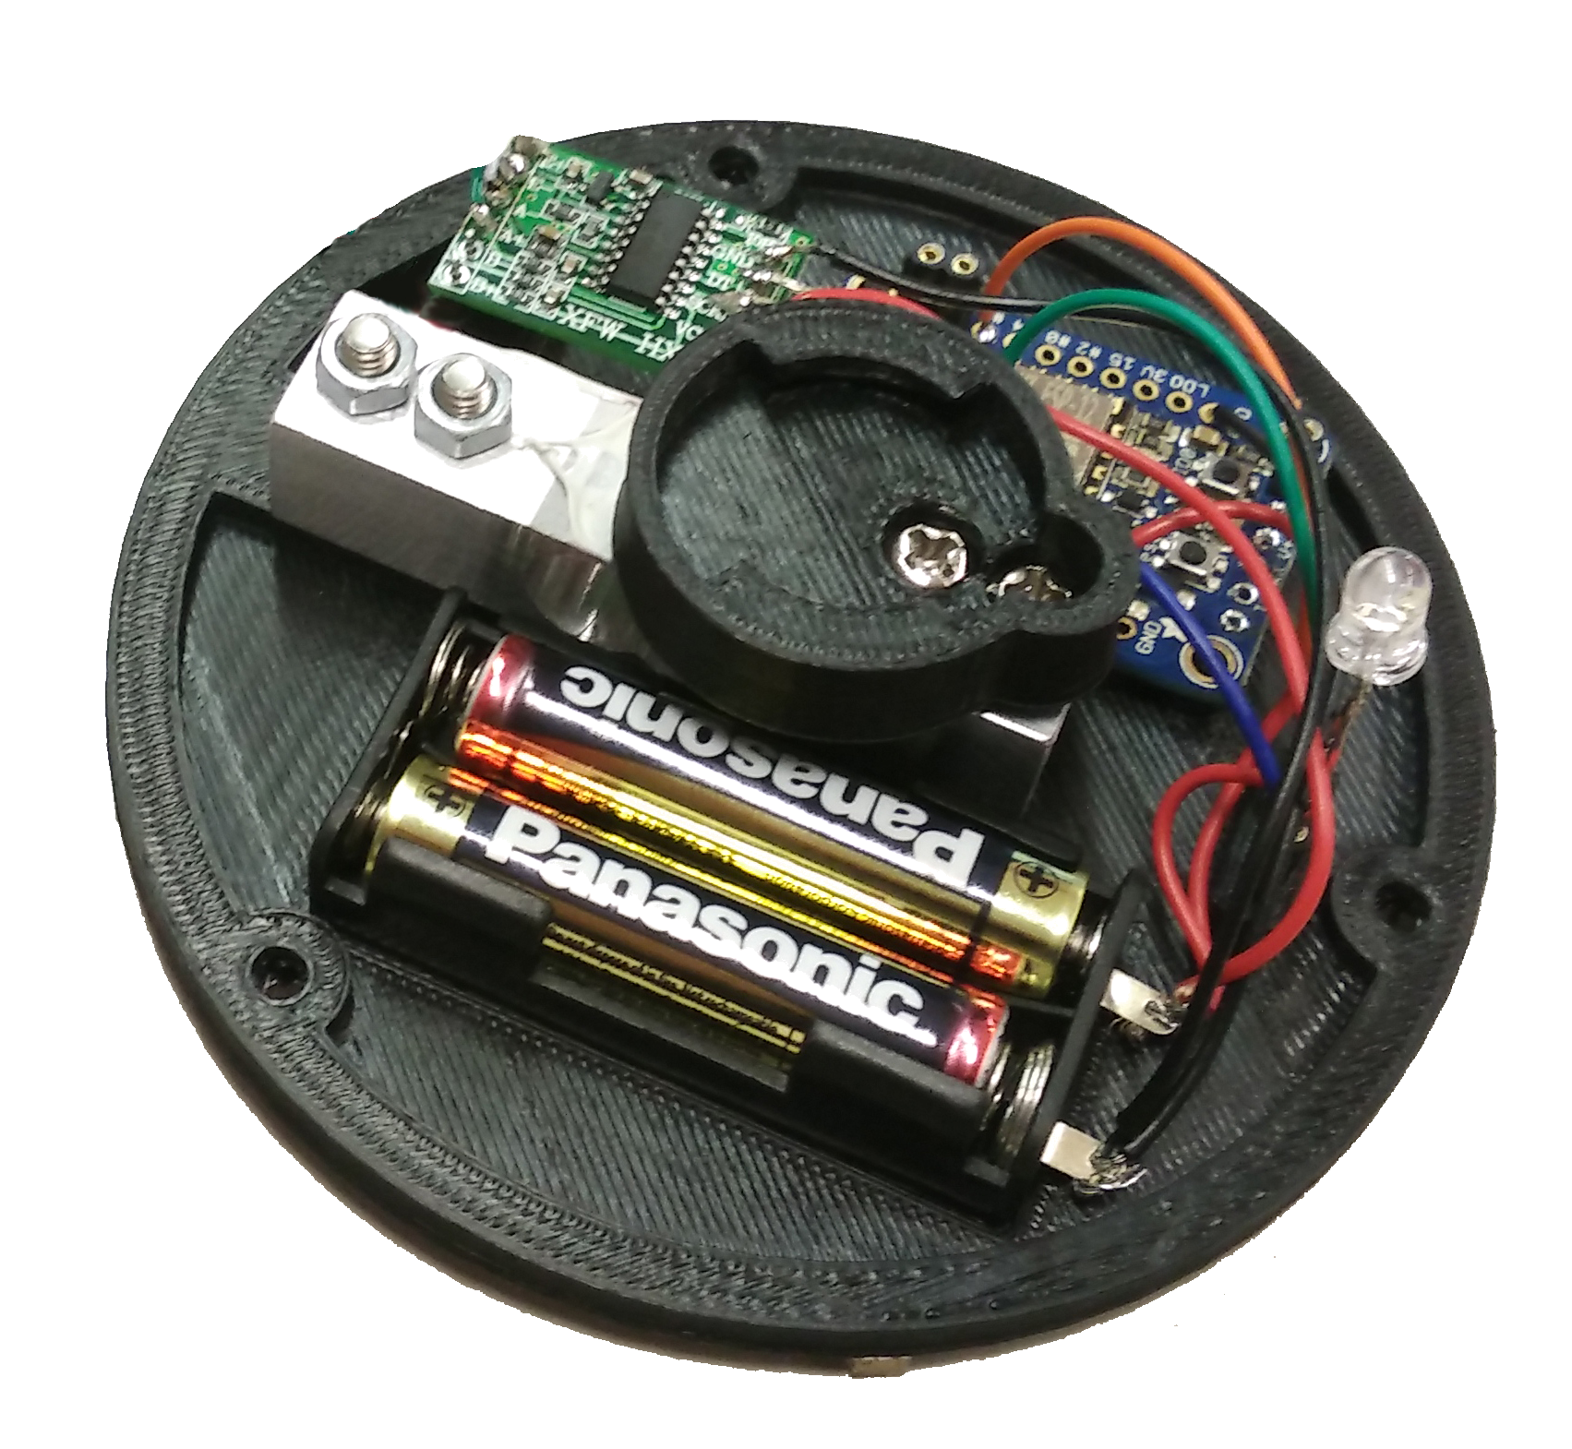
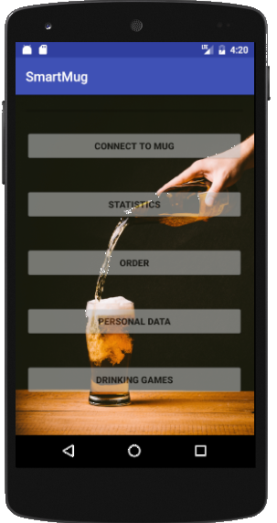
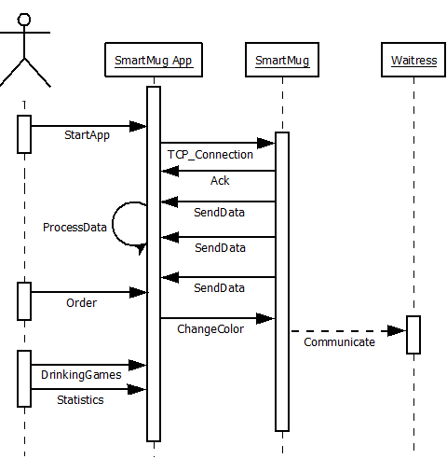
SmartMug
The clever way to order
Martin Dold, Larraitz Orio,
Gürkan Karacocuk, Dennis Tritschler
Architecture
Android App: Connects to the SmartMug
Wifi access: Wireless Communication
Mug: Standard Mug
Smart Mug: Extension to make your mug smart
Functions
Connection to mug via bar code reading
Liquid level sensing via weight (HX711 circuit)
Drinking statistic analysis via app
Interactive drinking games via app
Waitress communication by changing mug color
SmartMug
SmartMug App
Connect to your
SmartMug via Bar Code
or by entering
manuell the IP Adress
Display some statistics
Like promile
Enter your personal Data
For some statistics
Order via SmartMug
Play some drinking
games
Connection
SmartMug Protocol
TCP/IP → Wireless LAN according to
IEEE802.11b/g standard
Multicast DNS → Service name and Service type
Sequenzdiagramm
Tag 1byte | Length 1byte | Value n bytes | End of Frame 1 byte
Outlook
- Connection to the Barkeeper → Live Data for the Barkeeper, direct re-order function
- Payment via app
- Capacitive measurement instead by weight
- Connection between taps and Smart Mug for automated exact filling level

